Slide 1
Machine Learning Driven Device Co-Optimization
-parth Dembla

Slide 2
Table of Contents
Motivation
Problem Statement
Methodology
Basics of Inverter
Delay models for Inverter
Experimentation ;
Observation & results
Conclusion
Future Work
References

Slide 3
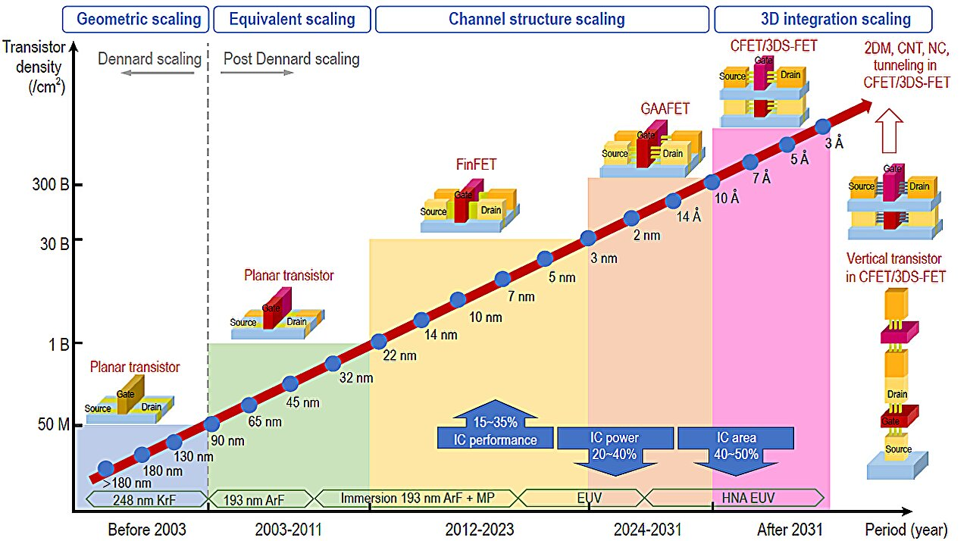
CMOS Scaling :-
*source : New structure transistors for advanced technology node CMOS ICs

Slide 4
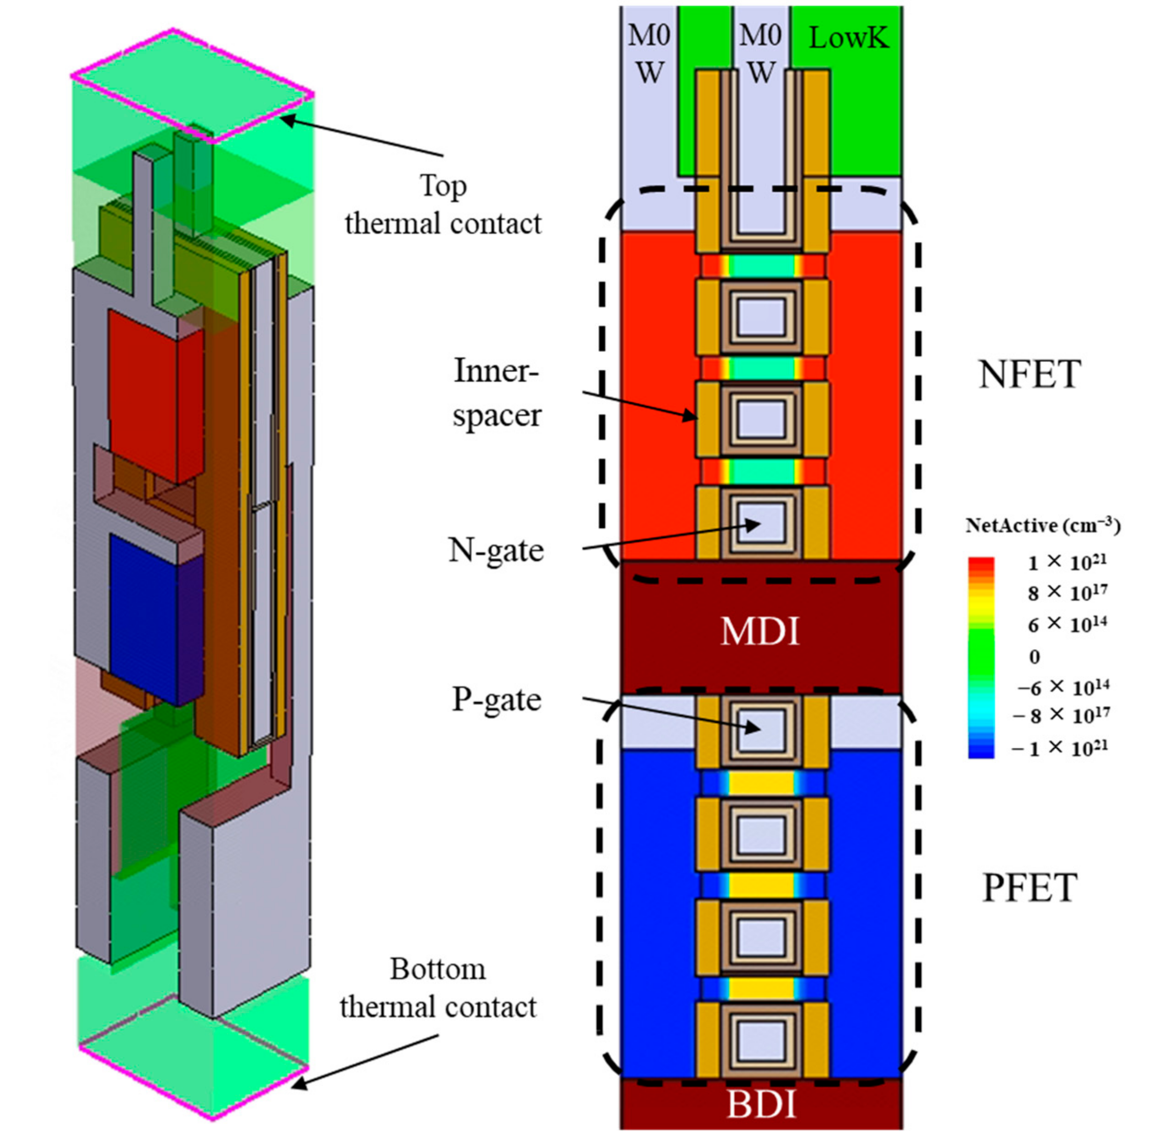
Complementary FET structure
Successor to GAAFET
A 3D stacked device architecture with NFET over PFET
Higher transistor density (no side-by-side layout)
Saves Chip Area
*Source : Pan, Z., Liu, T., Yang, J., & Zhang, D. W. (2023). A Buried Thermal Rail (BTR) Technology to Improve Electrothermal Characteristics of Complementary Field-Effect Transistor (CFET). ResearchGate.

Slide 5
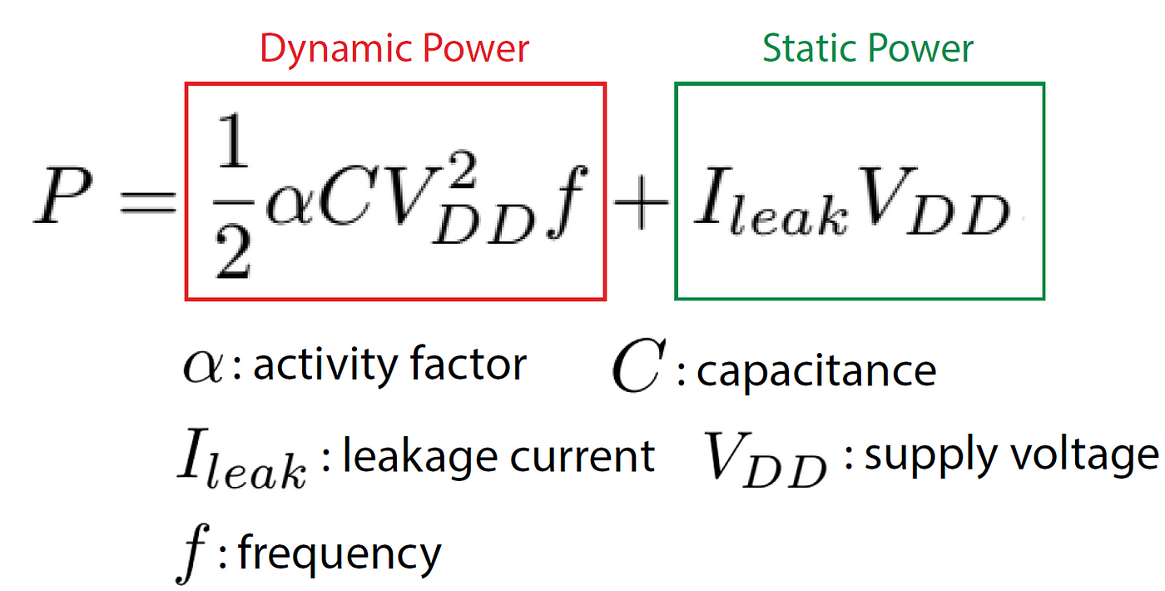

As transistor become smaller, structures become more complex, circuits become more highly integrated, and optimization of nonlinear device performance becomes more difficult
One of the key trade – off in IC design => Speed(Delay) + Efficiency (Power)
Speed => increase with increase in I_{ON}
Static Power Consumption =>decrease with decrease in I_{off} (less leakage) Dynamic Power Consumption => related with switching
Why optimization is important :-
Reducing delay makes circuits faster.
Reducing power improves thermal reliability and reduces packaging cost.
Problem Statement:-
Predict and optimize the inverter design {width(W), length(L), number of sheets(N)} to meet specified power and delay requirements for advanced nanosheet FET and CFET-based technologies

Slide 6
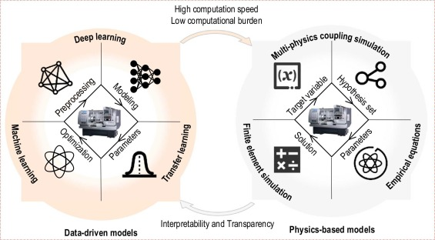
Solution Approach
Developing an analytical model for inverter delay and power as functions of key parameters such as effective current and capacitance.
Build a Deep Neural Network (DNN)-based forward model to predict current and capacitance values for inverter design parameters (W, L, N). Implementing optimization algorithms like Bayesian or grid search .
TCAD simulations of state-of-the-art devices are time-consuming.
These simulations incur high computational costs to obtain optimal design parameters before Manufacturing Process Evaluation ; that’s where ML as a solution can work
*Source : J. Wang, Y. Li, R. X. Gao, and F. Zhang, "Hybrid physics-based and data-driven models for smart manufacturing: Modelling, simulation, and explainability," Journal of Manufacturing Systems, vol. 63, pp. 540–553, 2022. [Online]. Available: https://doi.org/10.1016/j.jmsy.2022.02.008

Slide 7
Why to develop an analytical model?
Data Driven Model
Physics Based Model
Use machine learning (ML), deep learning (DL), and statistical methods to model a system by learning from experimental or simulated data
Cleaning and preparing data for modeling; fine tuning ; extraction of data without physical interpretability
May fail in unseen scenarios not seen in training
hence difficult to generelise
Use mathematical equations derived from physical principles
High interpretability and transparency
Generalizable and robust to new conditions.
Time-consuming to simulate especially in complex, multi-scale systems.
*If from an analytical model , we know what are the current and capacitance ranges to look for , we can proceed accordingly

Slide 8
METHODOLOGY
Analytical Model Formulation for delay and power
Validating it using mixed mode simulations (formulating analytical model helps to reduce this)
From the data obtained from TCAD ; develop a DNN based forward model which gets trained on this data
The output of this feed forward model can give us the parameters that we can feed into TCAD to have an optimised design for inverter
Use optimization algorithms like Bayesian optimization or grid search

Slide 9
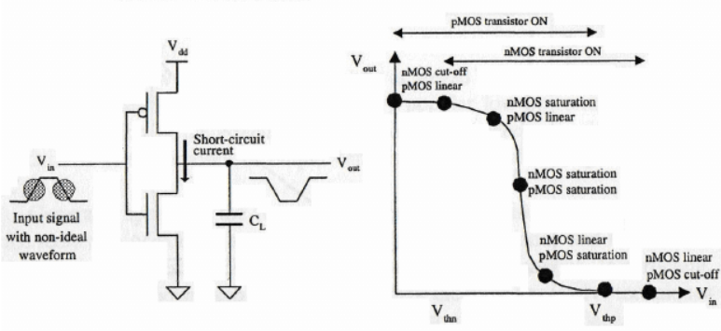
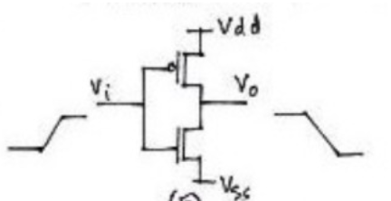
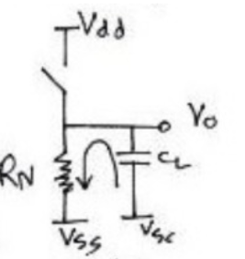
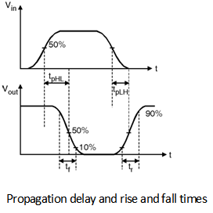
Basics of inverter
*source : K. Eshraghian, D.A. Pucknell, and S.M. Kang, CMOS Digital Integrated Circuits: Analysis and Design, 3rd ed. New York: McGraw-Hill, 2003.

Slide 10
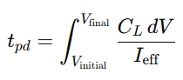
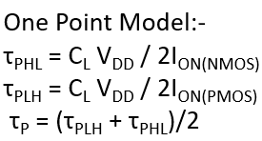
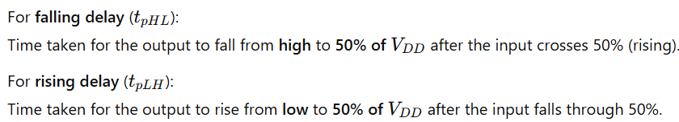
Existing Delay Models Used
I_{effective} => To model
One Point Model
Uses the equation such that I_{effective} is taken as I_{ON}
I_{ON} was taken as I_{dsat} = I_{d}(V_{GS}=V_{DD} , V_{DS} = V_{DD})
Why I_{ON} was used? :-
It represents the peak drive strength of the transistor.
The actual transient current does not remain constant but stays close to this value during a significant portion of switching

Slide 11
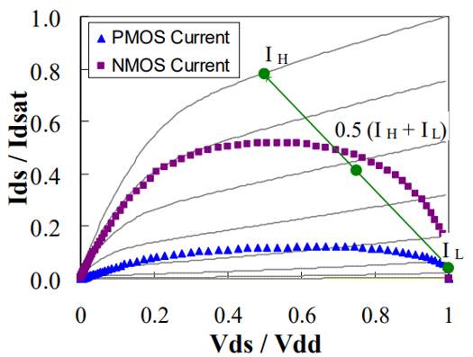
2) Two Point Model For Effective Drive Current
The actual delay of a CMOS inverter depends on the transient current profiles during switching, which are influenced by the varying V_{GS} & V_{DS}​ voltages.
I_{dsat}​, being constant, does not account for these variations and fails to capture the dynamics of switching accurately; hence one point model is not that accurate (under estimation of delay)
New model proposed which could capture transient behavior as well
Two Point Model:-
I_{effective(NMOS)} =( I_{NL} + I_{NH} )/2
I_{effective(PMOS)} =( I_{PL} + I_{PH} )/2
τ_{PHL} = C_{L} V_{DD} / 2I_{effective(NMOS)}
τ_{PLH} = C_{L} V_{DD} / 2I_{effective(PMOS)}
τ_{P} = (τ_{PLH} + τ_{PHL})/2
I_{H} = I_{ds} (V_{GS} = V_{dd} and V_{DS} = 0.5V_{dd} )
I_{L} = I_{ds} (V_{GS} = 0.5 V_{dd} and V_{DS} = V_{dd} )
Hu, Jenny, et al. "Effective drive current in CMOS inverters for sub-45 nm technologies." Proc. NSTI Bio-NanoTech. Conf. Trade Show. Vol. 3. 2008.

Slide 12
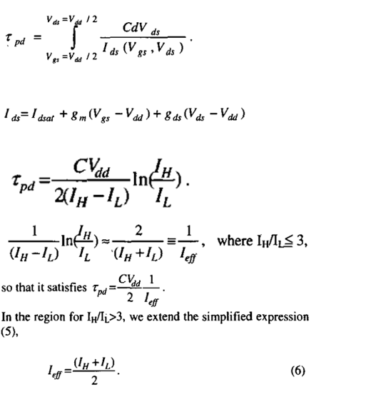

Slide 13
3) Three Point Model
To introduce another transient point in between ; a three point model approach is proposed
Three Point Model:-
I_{effective(NMOS)} =( I_{NL} + I_{NH} + I_{NM} )/3
I_{effective(PMOS)} =( I_{PL} + I_{PH} + I_{PM} )/3
τ_{PHL} = C_{L} V_{DD} / 2I_{effective(NMOS)}
τ_{PLH} = C_{L} V_{DD} / 2I_{effective(PMOS)}
τ_{P} = (τ_{PLH} + τ_{PHL})/2
I_{H} = I_{ds} (V_{GS} = V_{DD} and V_{DS} = 0.5V_{DD} )
I_{L} = I_{ds} (V_{GS} = 0.5 V_{DD} and V_{DS} = V_{dd} )
I_{M} =I_{ds}(V_{GS}=0.75 V_{DD}, V_{DS}=0.75 V_{DD}).

Slide 14
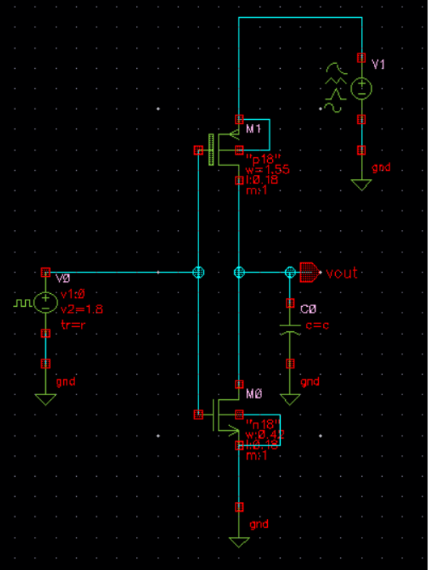
To start formulating the analytical model , inverter was simulated in cadence simulation software by taking different load capacitances.
Following Design Parameters were used for inverter design
Gate Length(Same for PMOS NMOS) | Gate Width PMOS | Gate Width NMOS | V_{DD} | C_{parasitic(d,g+d,b)} | V_{th} PMOS | V_{th} NMOS
180 nm | 1550 nm | 420 nm | 1.8V | 4fF | -502 mV | 468mV
(so the C_{Load} is varied from 100fF to 4500 fF ; in order to ignore the parasitic capacitances effects )
I_{ON} (PMOS) = 374.543 μA
I_{ON} (NMOS) = 243.61 μA

Slide 15
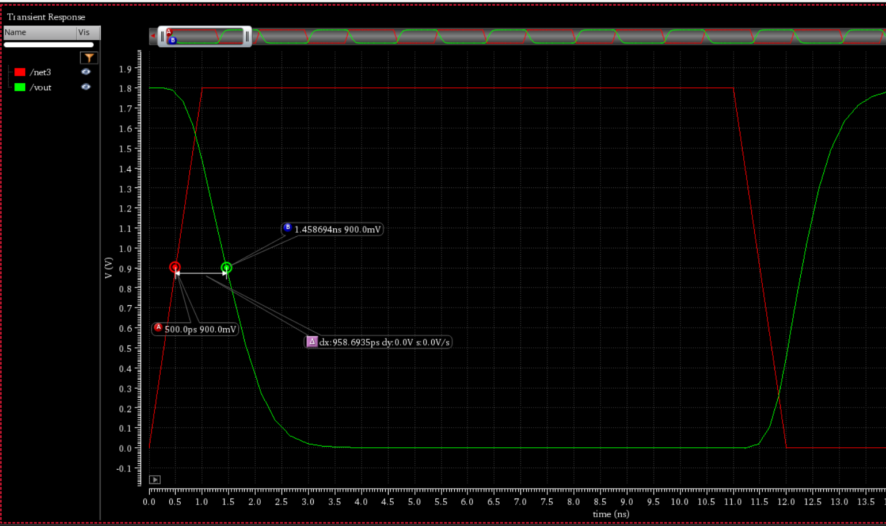
I_{dnmos} (V_{GS} = 0.5 V_{DD} , V_{DS} = V_{DD} ) = I_{NL} = 48.271 μA
I_{dpmos} (V_{GS} = 0.5 V_{DD} , V_{DS} = V_{DD} ) = I_{PL} = 78.67 μA
I_{dnmos} (V_{GS} = V_{DD} , V_{DS} = 0.5V_{DD} ) = I_{NH} = 233.78 μA
I_{dpmos} (V_{GS} = V_{DD} , V_{DS} = 0.5V_{DD} ) = I_{PH} = 327.25 μA
I_{dnmos} (V_{GS} = 0.75 V_{DD} , V_{DS} = 0.75V_{DD} ) = I_{NM} = 138.112 μA
I_{dpmos} (V_{GS} = 0.75 V_{DD} , V_{DS} = 0.75V_{DD} ) = I_{PM} = 201.743 μA
Input Pulse:-
Time Period = 100ns
ON Time = 55ns
Rise time = fall time =1ns
Delay time = 0
From these calculations delay from simulations were tabulated and errors were calculated with respect to simulation delay for different load capacitances

Slide 16
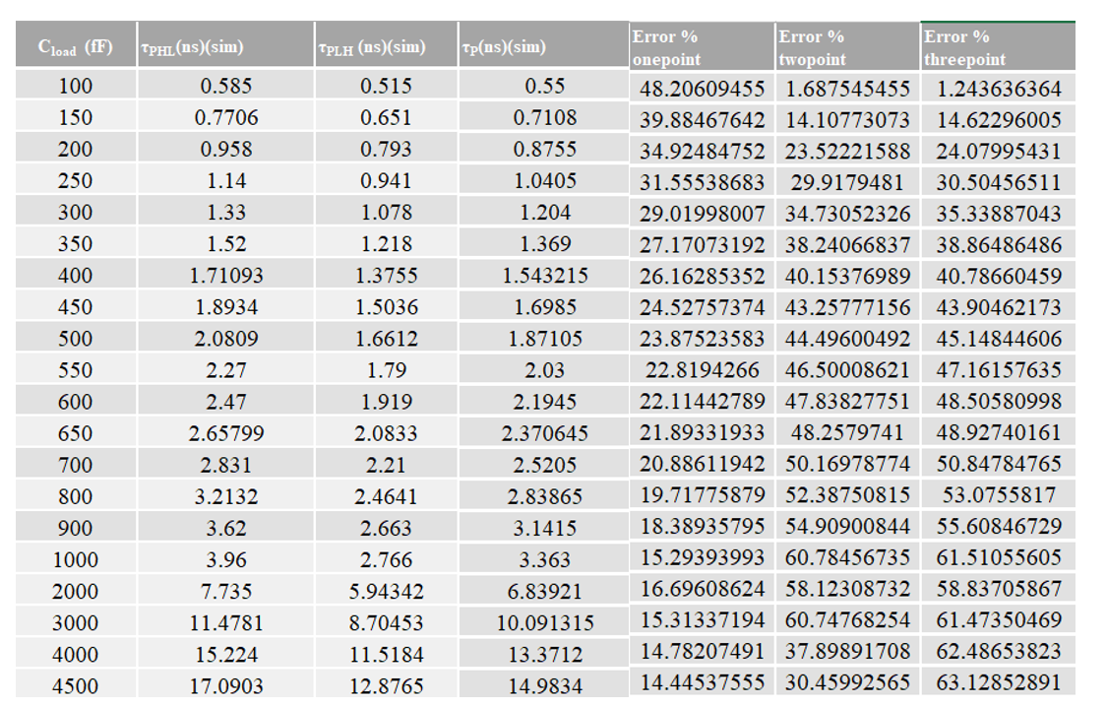

Slide 17
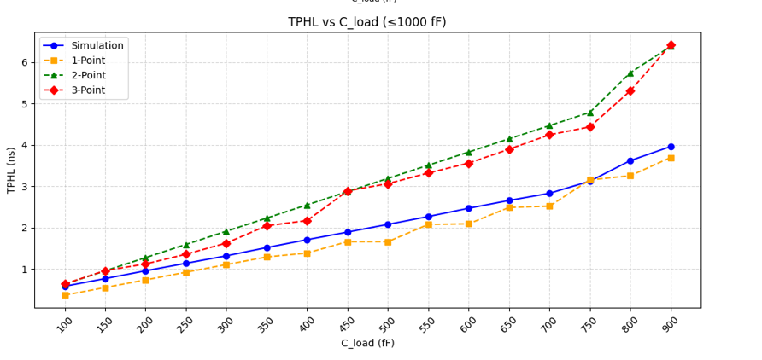
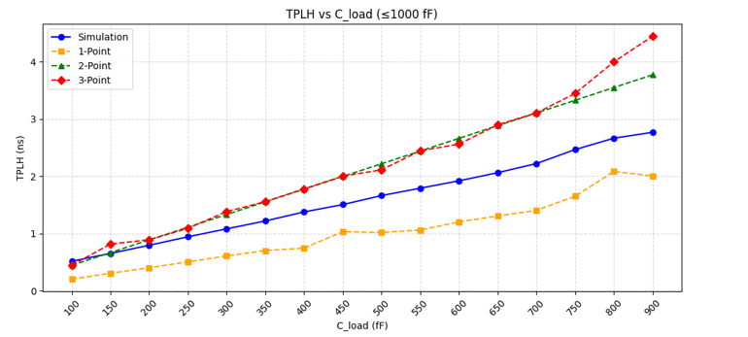
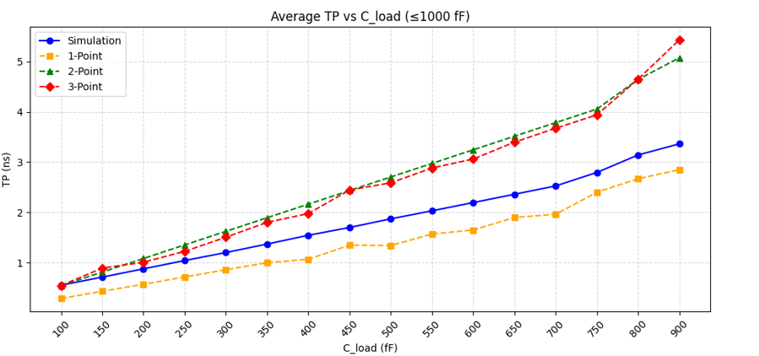
Worst Case Errors:-
One point model: 48%
Two point model: 60%
Three point model: 61%

Slide 18
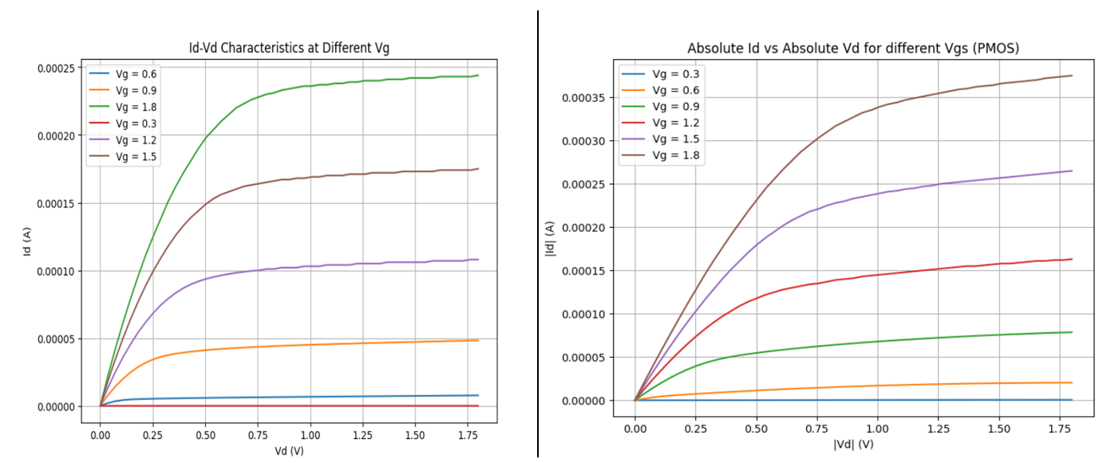
NMOS
PMOS

Slide 19
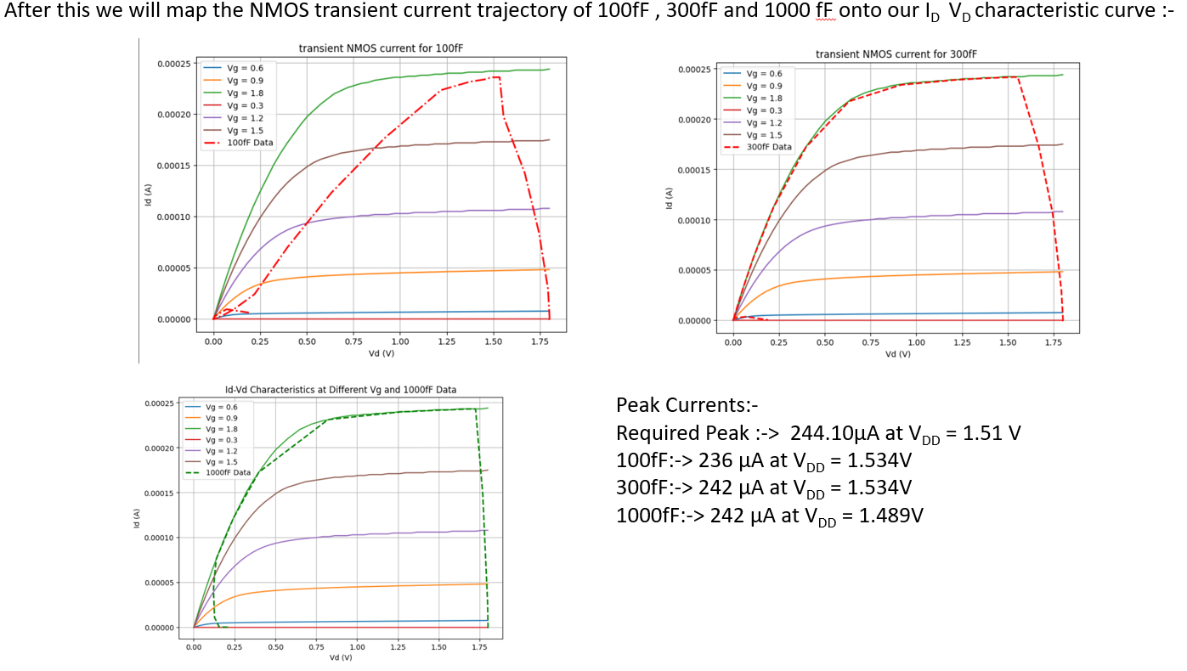

Slide 20
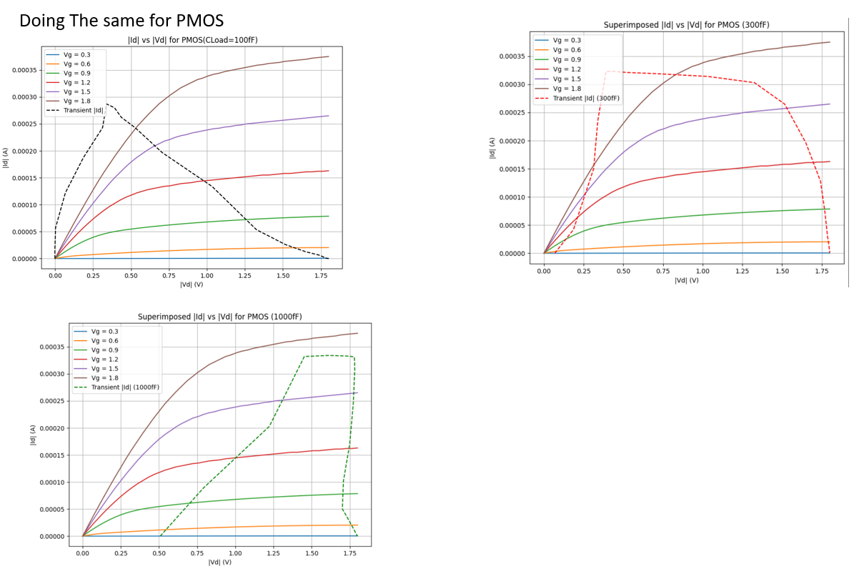

Slide 21
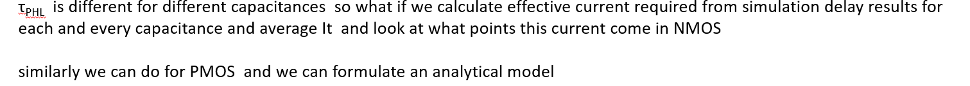
First Approach :-
For NMOS – > average current is 207.4 μA coming at I_{DS} (V_{GS} = V_{DD} , V_{DS} = 0.3V_{DD})
For PMOS -> average current is 262.8014 μA coming at I_{DS} (V_{GS} = 5V_{DD} /6 and V_{DS}= V_{DD})

Slide 22
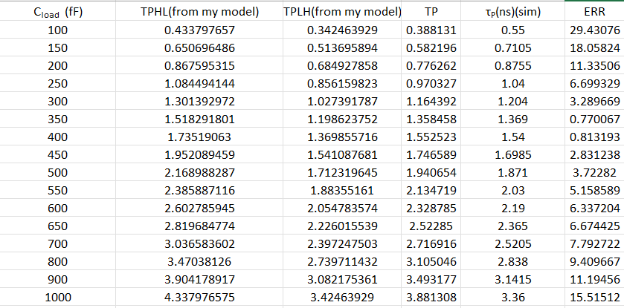
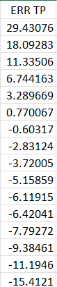

Slide 23
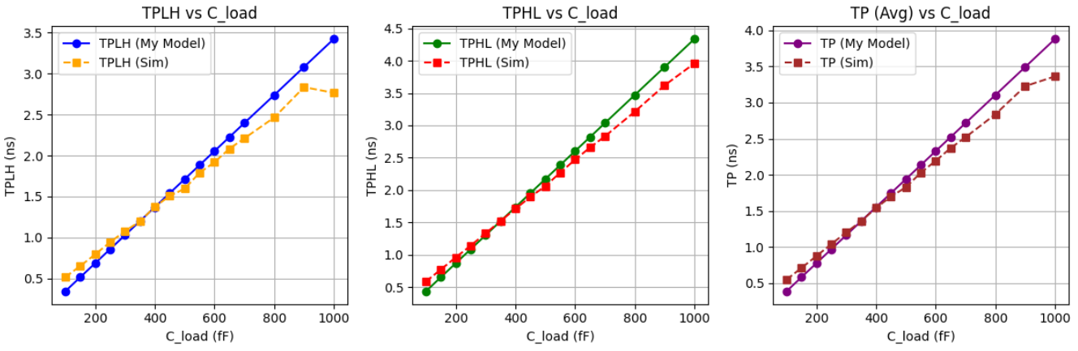
Results From First Approach

Slide 24
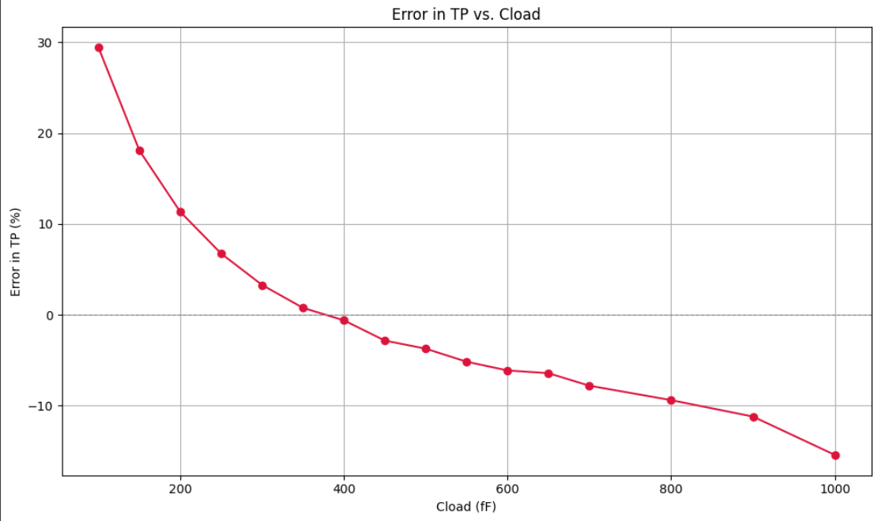

Slide 25
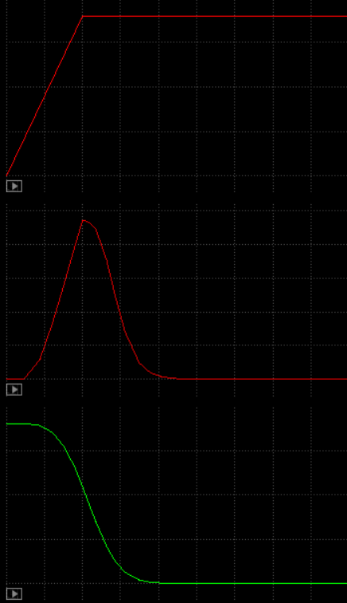
Second Approach :-
Find the average transient current during charging and discharging and fit it to get I_{effective}
Input Pulse Going Low to High =>
Average Value of Current
(similarly we can do for PMOS)
NMOS transient current =>
Output Voltage Going High to Low =>

Slide 26
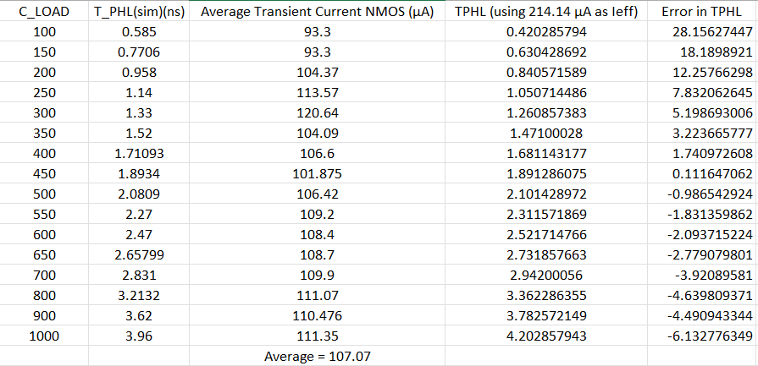
Average of all the I_{avg,transient} = 107.07 μA
To fit with required current (empirically) ; multiply by factor of 2
Therefore ; I_{eff} = 214.14 μA
This I_{eff} = I_{DS,NMOS} (V_{GS} = V_{DD ;} V_{DS} = V_{DD}/3)

Slide 27
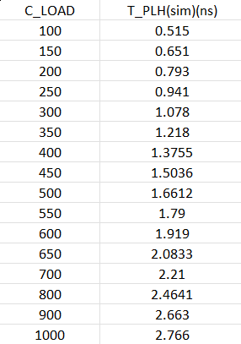
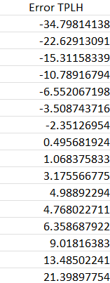
Average of all the I_{avg,transient} = 107.21 μA
To fit with required current (empirically) ; multiply by factor of 2.5
Therefore ; I_{eff} = 268.025 μA
This I_{eff} = I_{DS,PMOS} (V_{GS} = V_{DD ;} V_{DS} = V_{DD}/3)
Same Voltage Points as NMOS

Slide 28
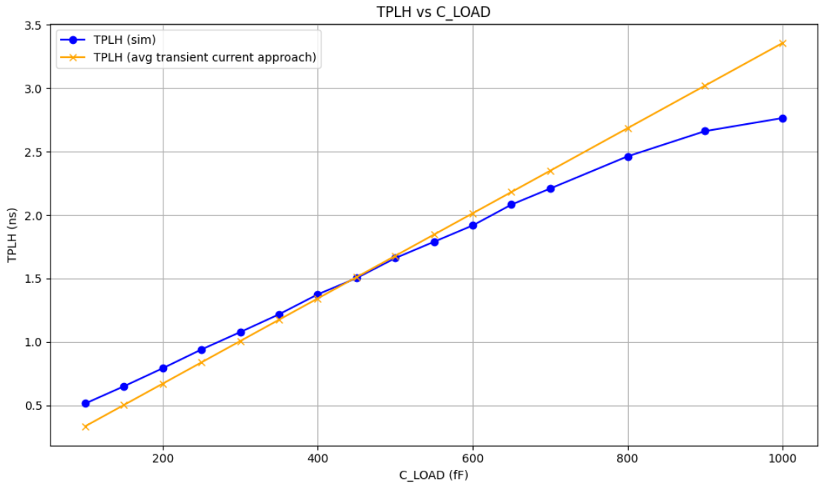
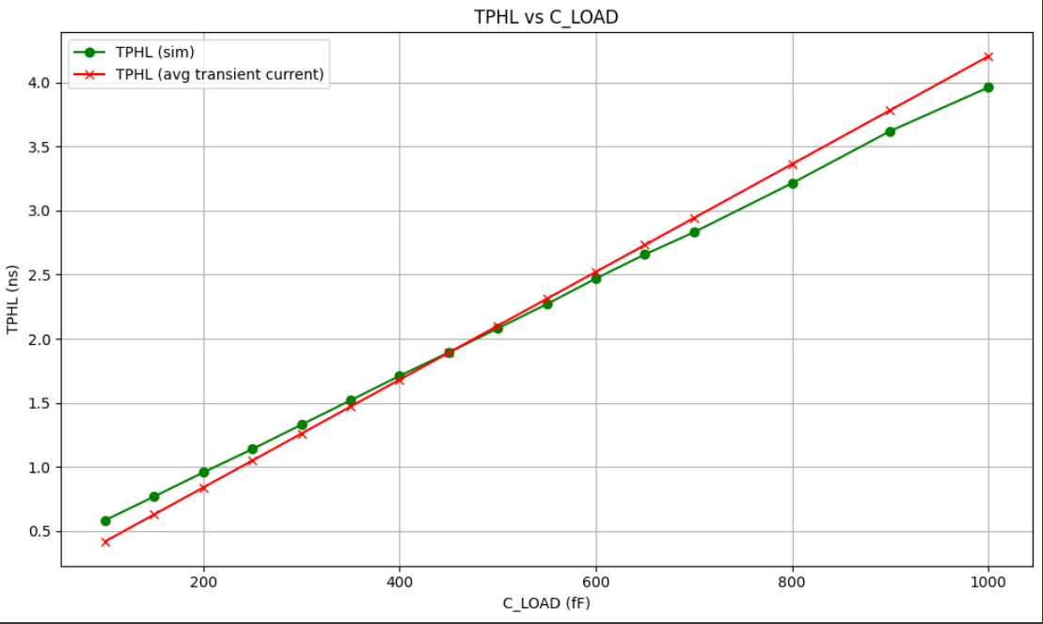
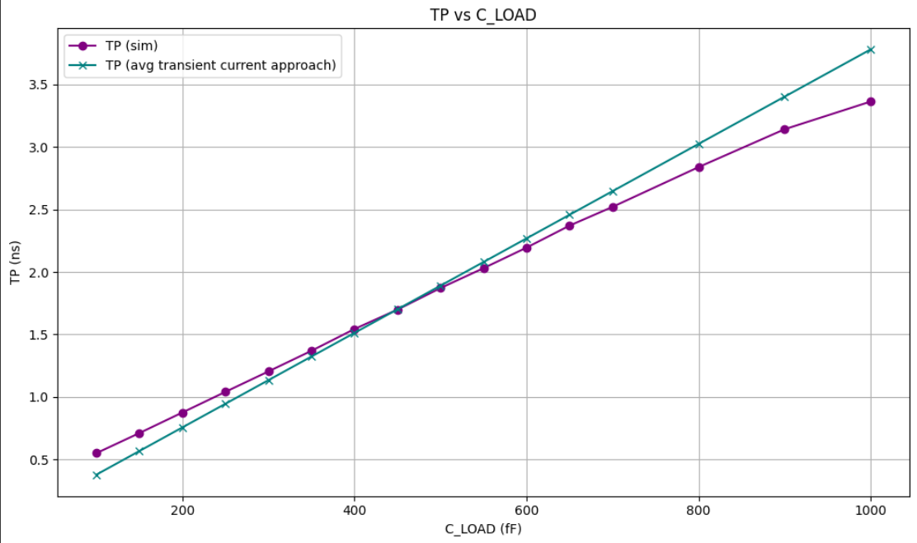
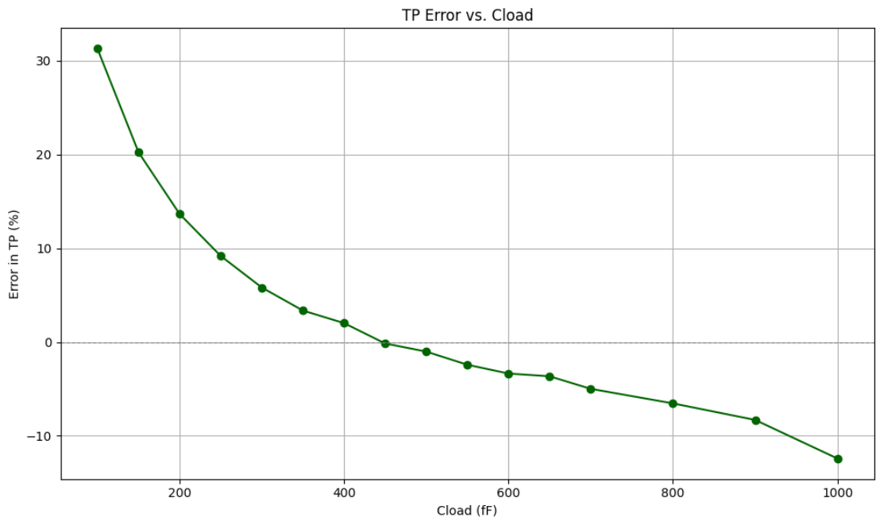

Slide 29
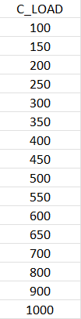
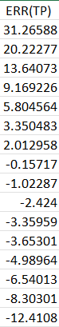

Slide 30
Conclusion
From both the approaches ; the worst case errors are same ; Approx.: +30% to -15%
To form an analytical model effectively ; one can take the average of transient currents for both PMOS and NMOS during low to high and high to low transitions of output voltage respectively
Multiply the current by a factor in order to get the require delay.
The resultant current obtained at particular voltage points can be taken as the I_{effective} in denominator of the delay equation.

Slide 31
Future Work:-
Validate the same procedure using TCAD simulations
Develop a Physics Based ML model to train the parameters using the formulated model
Implement the model for scaling across technologies
Apply methodology to different logic gates and circuits beyond inverter
Incorporate parasitics and interconnect effects in delay modeling
For Short channels equations may change (e.g. Adding DIBL coefficient; applying alpha-power MOS model for current equation)
Build a compact model library to replace time-consuming simulations

Slide 32
References :-
[1]C. F. Chen, M. H. Chiang, C. Hu, and P. K. Ko, “Alpha-power law MOSFET model and its applications to CMOS inverter delay and other formulas,” IEEE Journal of Solid-State Circuits, vol. 25, no. 2, pp. 584-594, Apr. 1990. doi: 10.1109/4.52187.
[2]B. Andreev, E. L. Titlebaum, and E. G. Friedman, “Sizing CMOS inverters with Miller effect and threshold voltage variations,” J. Circuits, Syst., Comput., vol. 15, no. 3, pp. 437–454, Oct. 2006. doi: 10.1142/S0218126606003142.
[3]F. S. Marranghello, A. I. Reis, and R. P. Ribas, “Improving analytical delay modeling for CMOS inverters,” J. Integr. Circuits Syst., vol. 10, no. 2, pp. 123–134, 2015.
[4]L. Xue, A. Dixit, N. Kumar, V. Georgiev, and B. Liu, “Machine learning-assisted device circuit co-optimization: A case study on inverter,” IEEE Trans. Electron Devices, vol. 71, no. 1, pp. 1-10, 2024. doi: 10.1109/TED.2024.3476231.
[5]N. Hedenstierna and K. O. Jeppson, “CMOS circuit speed and buffer optimization,” IEEE Trans. Comput.-Aided Des. Integr. Circuits Syst., vol. 6, no. 2, pp. 270–281, Mar. 1987. doi: 10.1109/TCAD.1987.1270271.
:[6] K. Eshraghian, D.A. Pucknell, and S.M. Kang, CMOS Digital Integrated Circuits: Analysis and Design, 3rd ed. New York: McGraw-Hill, 2003
[7]H. Jeong et al., “MOBO-driven advanced sub-3-nm device optimization for enhanced PDP performance,” IEEE Transactions on Electron Devices, 2024. doi: 10.1109/TED.2024.3378224
[8]A. Razavieh et al., “Effective drive current in scaled FinFET and NSFET CMOS inverters,” in Proc. Device Research Conference (DRC), 2018, pp. 1–2. doi: 10.1109/DRC.2018.8442220

Slide 33
THANK YOU

